Slide 1
Command Design Pattern
A Hands-On Workshop

Slide 2
Problem
You are working on a text editor app.
The app has multipile buttons with different functions.
You create a Button-Class and many subclasses
But what is when you have a SaveButto, SaveShorcut and Save in ContextMenu?

Slide 3
Solution: Use Command Pattern

Slide 4
What does the command pattern?
The command pattern encapsulates a request as an object
It seperates the requester of an action from the object that performs the action.
So you Create a SaveCommand and each SaveAction on the GUI can call it.

Slide 5
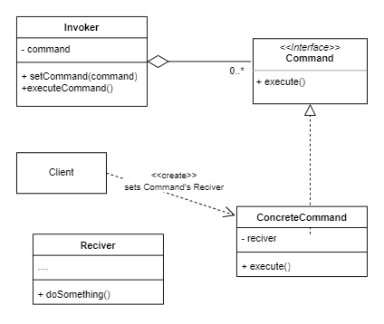
The Actors
The Invoker
The Command Interface
The ConcreteCommand
Reciver (e.g.Business Object)

Slide 6
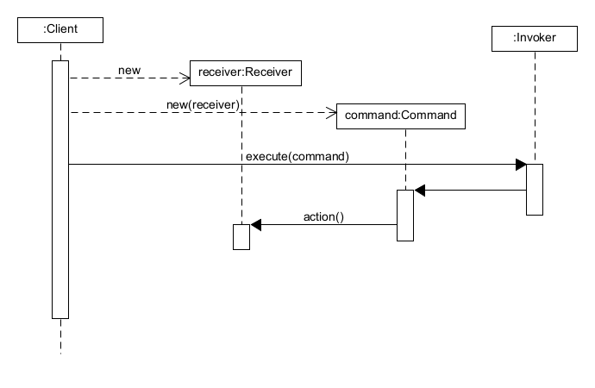
Sequence diagram

Slide 7
Sequence diagram

Slide 8
Real world analogy
To better understand the Command pattern, let's consider an example of a restaurant ordering system. In this scenario, the waiter acts as the invoker, the chef as the receiver, and the order as the command. When a customer places an order, the waiter creates a command object that contains all the necessary information about the order and passes it to the chef. The chef then executes the command by preparing the food and delivering it to the customer. By using the Command pattern, we can easily modify the system to add new dishes or change the way orders are processed without affecting the existing code.

Slide 9
Pros and Cons
Pros | Cons
Single Responsibility Principle You can decouple classes that invoke operations from classes that perform these operations | The code may become more complicated since you‘re introducting a whole new layer between senders and recivers
Open/Closed Principle You cann introduce new commands into the app without breaking changes.
You can implement undo/redo
You can implement deferred execution of operations
You can assemble a simple set of simple commands into one complex.

Slide 10
Hands-On Workshop
Now we have covered the basics of the Command pattern
Time for practice
develop an application for a device control for a smart home. There are heating thermostats, lamps, blinds, vacuum cleaner robots.

Slide 11
When you shold choose command pattern?
Use the Command pattern when you want to implement reversible operations.
Use the Command pattern when you want to queue operations, schedule their execution, or execute them remotely.
Use the Command pattern when you want to parametrize objects with operations.

